Slide 1
Predictive Data MininG basketball playoffs qualification
André Sousa (up202005277) IF:1
Pedro Fonseca (up202008307) IF:1
Tomás Maciel (up202006845) IF:1
AC – MACHINE LEARNING 2023/2024

Slide 2
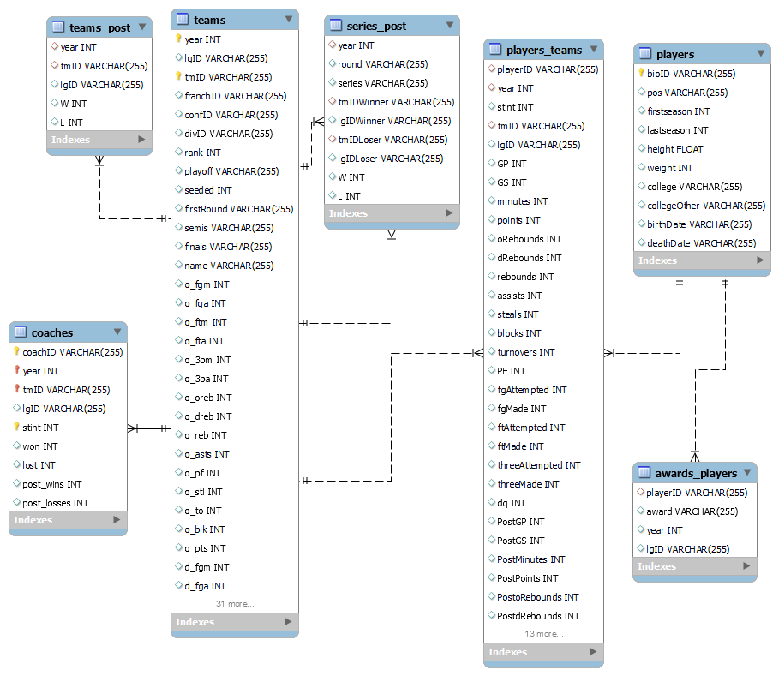
Domain description
For 10 seasons (years), data from players, teams, coaches, games, and several other metrics were gathered and arranged to create this dataset.
Our main goal is to develop a model that by using this data can predict which teams go to the playoffs (8 best teams from the standard season).

Slide 3
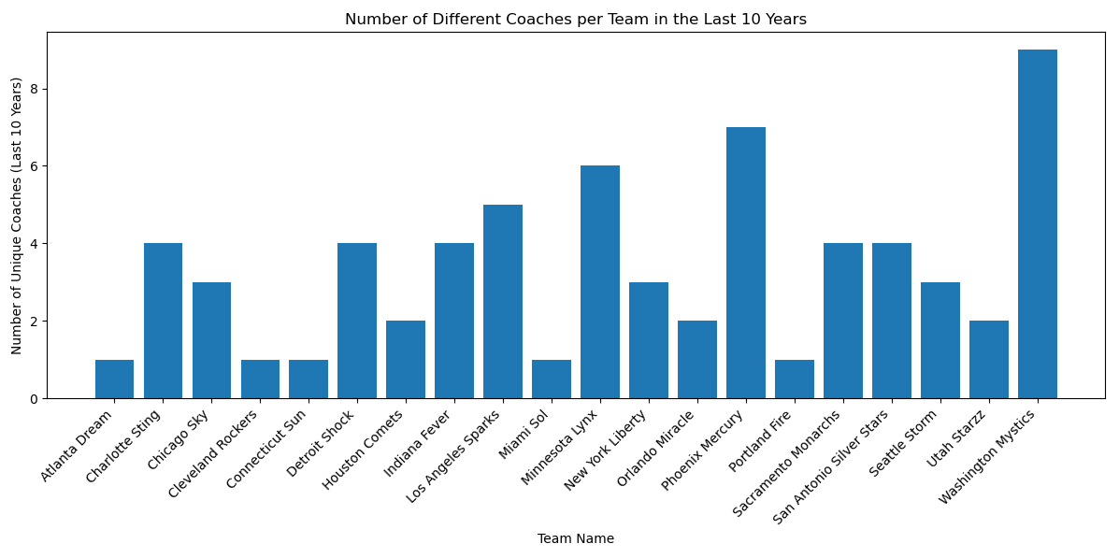
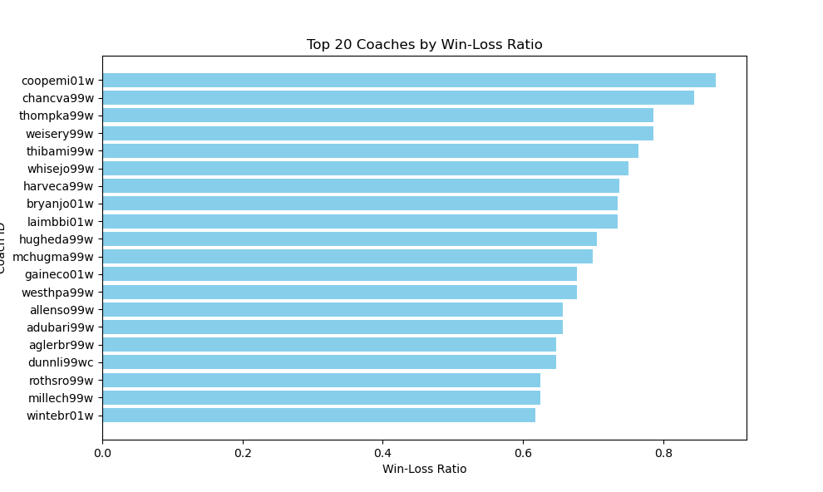
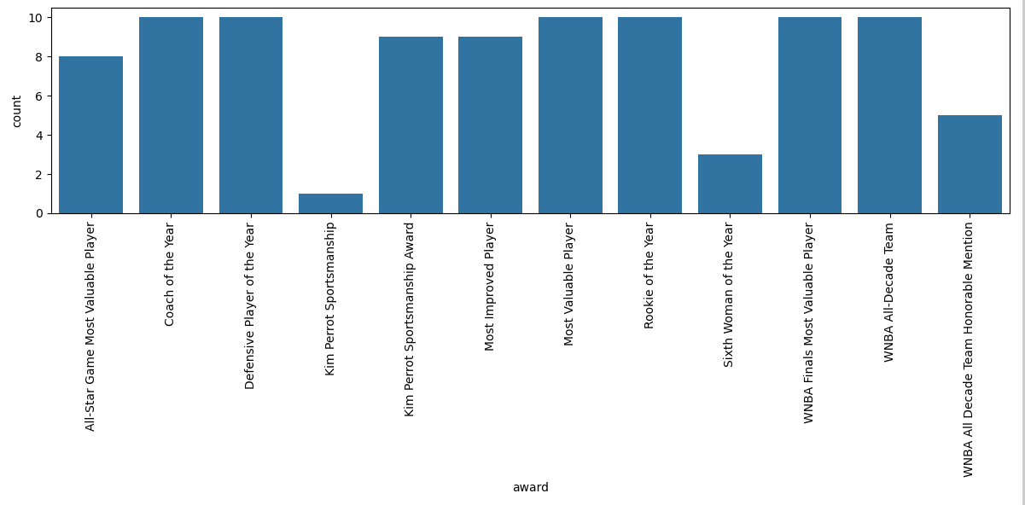
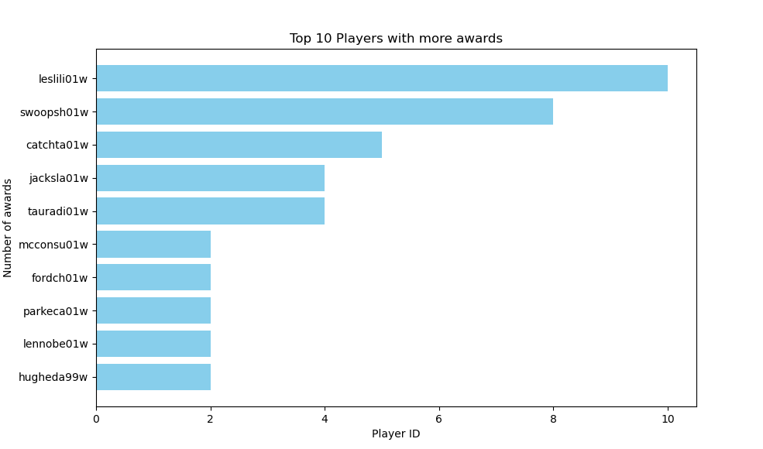
Exploratory Data Analysis 1/2
1
There have been teams with different coaches over the 10 years, however, a few kept the same coach. There are also teams that switch coaches during a season.
The 20 coaches with the higher Win-Loss Ratio.
The top 10 players with the most awards won, which suggests us the best players.
The number of awards given to players.
2
3
4

Slide 4
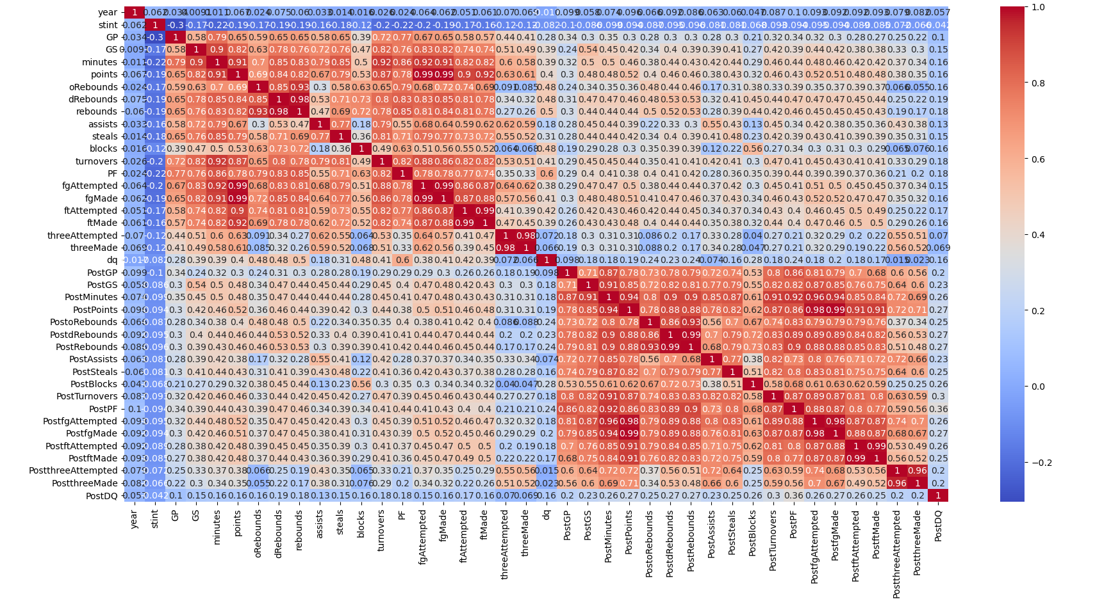
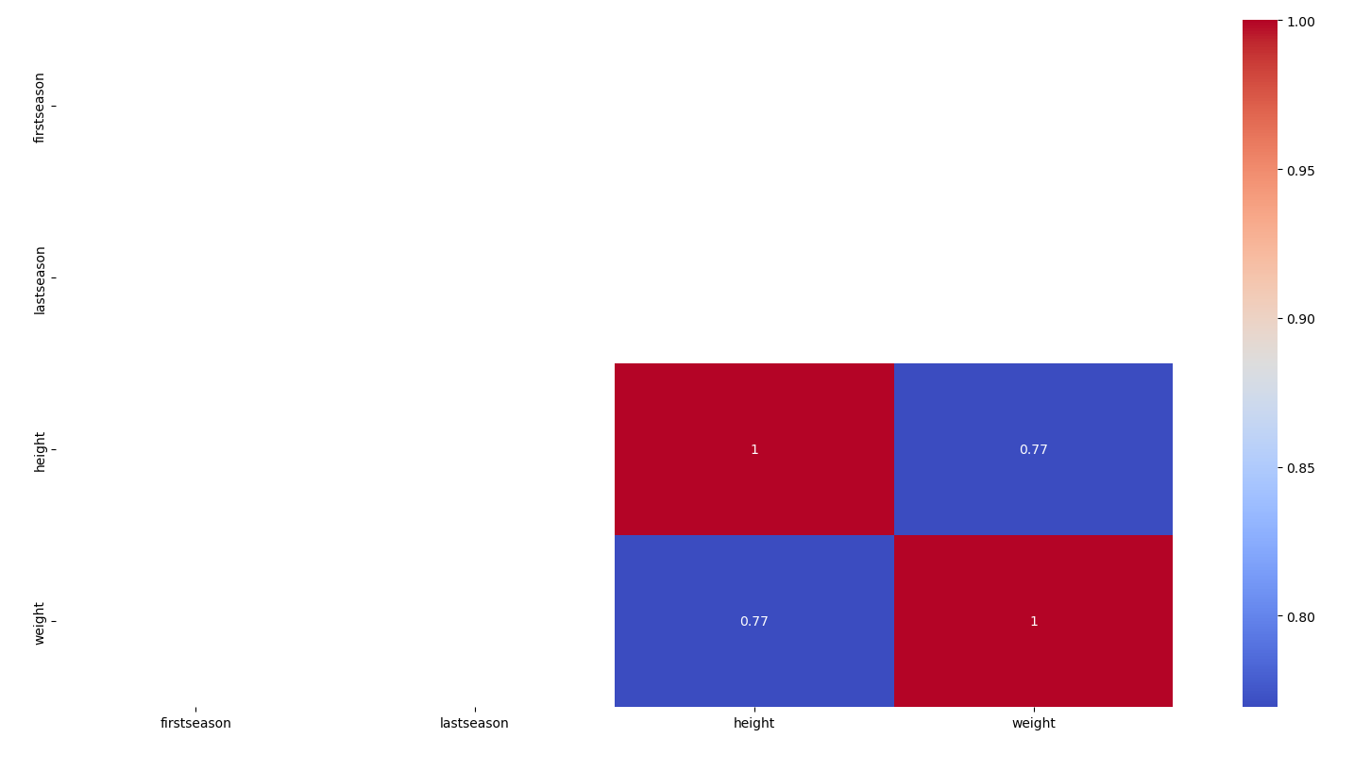
Exploratory Data Analysis 2/2
7
Team | Playoff Appearances
0 LAS | 9
1 SAC | 8
2 DET | 7
3 NYK | 7
4 SEA | 7
5 CON | 6
6 HOU | 6
7 IND | 6
8 WAS | 5
9 SAS | 3
10 CLE | 3
11 CHA | 3
12 PHO | 3
13 UTA | 2
14 MIN | 2
15 ORL | 1
16 MIA | 1
17 ATL | 1
5
The correlation matrix of players_teams allows us to see that many individual stats are correlated.
Correlation matrix, that shows us the high correlation between weight and height of a player.
Playoff appearances per team, show us the teams that are statistically more predictable to advance to playoffs again.
Playoff Wins per team that shows us the last winners of the playoffs.
6
8
Team | PlayOff Wins
0 DET | 3
1 LAS | 2
2 PHO | 2
3 HOU | 1
4 SEA | 1
5 SAC | 1

Slide 5
Problem Definition
This project delves into the domain of basketball tournaments, specifically focusing on the prediction of playoff qualification for teams. Basketball tournaments are traditionally divided into two phases: the standard season, where teams compete to accumulate the highest number of wins, and the playoffs, featuring knockout matches for the championship. The objective of this project is to utilize a decade's worth of comprehensive data, encompassing players, teams, coaches, games, and various performance metrics, to forecast which teams will qualify for the playoffs in the forthcoming season.
DATASET OVERVIEW:
The dataset at hand spans ten years, providing a rich and extensive repository of information relevant to basketball tournaments. It includes detailed player statistics and respective awards, team performance metrics, coaching data, and game-specific information. Furthermore, the dataset also provides data on the team's performance both in the season and in the post-season.
Moreover, the dataset is not provided as a typical one-table dataset. Instead, we were provided with data that was not previously cleaned and it was scattered through seven distinct tables.

Slide 6
Main Steps for playoff prediction
Feature Engineering in the different tables: creation, removal, and transformation of features.
Prediction of well-known player evaluation metrics, such as Efficiency (EFF) and Defensive Player Rating (DPR) that reflect the player’s performance in the upcoming season.
Prediction of every team’s results, according to the previously predicted statistics of their players.
Comparison between teams’ results and choice of the best 8 teams for qualification.

Slide 7
Data preparation 1/2
TABLE player
Drop irrelevant features: deathDate, rows of column “pos” with NaN values, firstSeason, lastSeason;
Drop players whose birthDate = 0000-00-00, since this is clearly a mistake;
Mapping colleges’ names and player’s positions to numerical indexes;
Update birthDate to birthYear (day and month are irrelevant for our goal);
Merge table awards with players, and then add a new attribute awards_count for each player.
TABLE players_teams
Feature Engineering (Creation of ‘EFF’, ‘DPR’, ‘FG_Percentage,’ ‘FT_Percentage’ and ‘PPG’ and drop the rows with null values of 'FG_Percentage', 'FT_Percentage', 'PPG’);
Merge players_teams with players by playerID (playerID matches bioID column present on player);
Creation of lagged features to be used with the prediction models.

Slide 8
Data preparation 2/2
TABLE series_post
Drop lgIDLoser and lgIDWinner (not relevant) and update ‘W’ and ‘L’ to percentages.
TABLE coaches
Creation of new columns on table coaches: ‘WLRatio’ and ‘WLRatio_Post’, representing the Win/Loss ratio in the standard season and in the postseason.
TABLE teams
Feature Engineering related to score (creation of ‘PredictedTeamScore’ and ‘RealTeamScore’);
More Feature Engineering (‘progress’, ‘offensive_performance’ and ‘defensive_performance’, …);
Merge of table coaches with teams;
Mapping of the playoff qualification to Boolean values (‘Y’=1 and ‘N’=0);
Creation of lagged features to be used with the prediction models.

Slide 9
LAGGED FEATURES
Including historical context in our data allows our models to catch trends and improve accuracy in the forecasting of variables.
Used in:
players_teams - 'FG_Percentage', 'FT_Percentage', 'PPG', 'EFF', 'DPR’;
teams - 'RealTeamScore', 'defensive_performance', 'offensive_performance', 'gamesWLRatio’, 'homeWLRatio', 'awayWLRatio', 'confWLRatio', 'progress', 'playoff’;
For each year we added the information of the X previous years, being X, the size of the sliding window used for testing (see annex: slide 21).
In case of non-existent values (happens when there are less than X prior years) we define the values as -1 except for playoff where we define them as 0.5 (represents uncertainty).

Slide 10
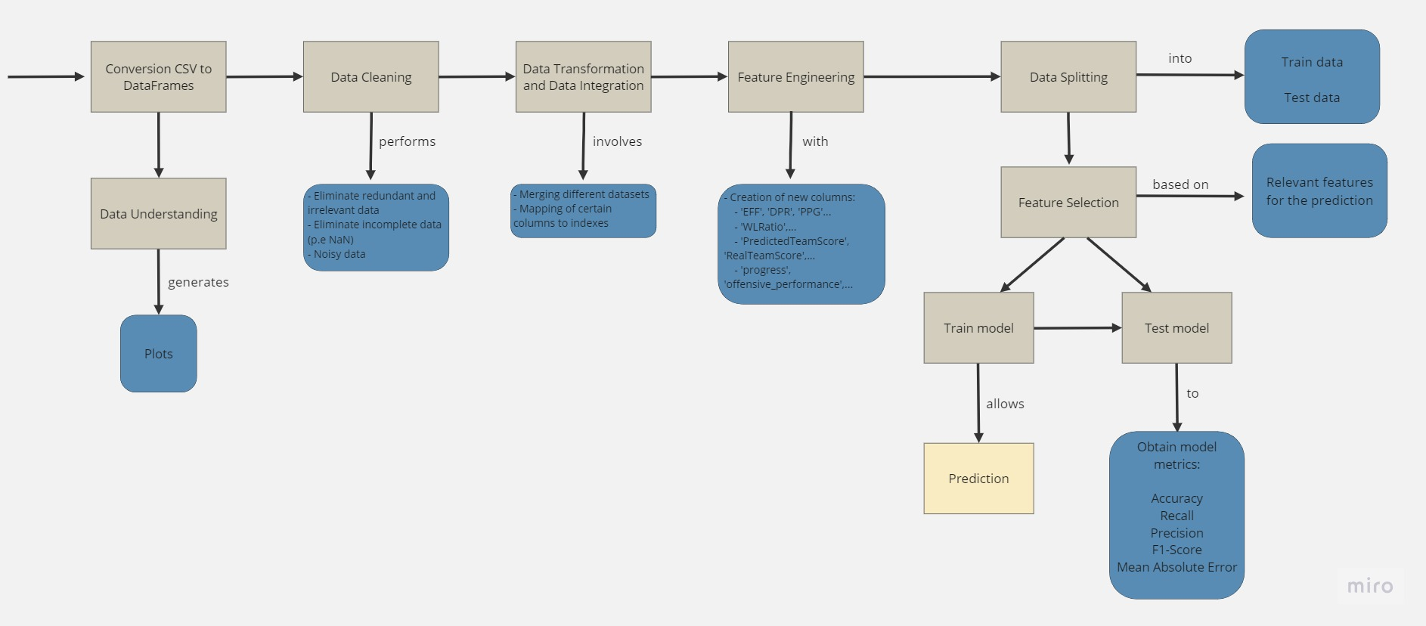

Experimental setup

Slide 11
Results 1/2
Model | Scaler | Best Score | Mean Absolute Error | R Squared
Random Forest Regressor | RobustScaler | 0.708 | 2.601 | 0.575
Lasso Regression | None | 0.527 | 2.548 | 0.590
Gradient Boosting Regressor | RobustScaler | 0.744 | 2.692 | 0.532
Support Vector Regressor | None | 0.726 | 4.015 | 0.027
To achieve the final prediction (playoffs), we made predictions on the players’ EFF and DPR, so that we could predict their individual performance.
To predict players' EFF, we utilized the 'Random Forest Regressor' model, which was selected from our previous testing.
The 'RobustScaler' was applied to enhance the accuracy of the EFF predictions.
For forecasting players' DPR, we maintained consistency by using the same 'Random Forest Regressor' model and 'RobustScaler' approach.
1
Model | Scaler | Best Score | Mean Absolute Error | R Squared
Random Forest Regressor | RobustScaler | 0.69358 | 246.68 | 0.564
Lasso Regression | None | 0.487 | 237.417 | 0.5929
Gradient Boosting Regressor | RobustScaler | 0.733 | 262.191 | 0.489
Support Vector Regressor | None | 0.710 | 367.87 | 0.0196
1
2
2

Slide 12
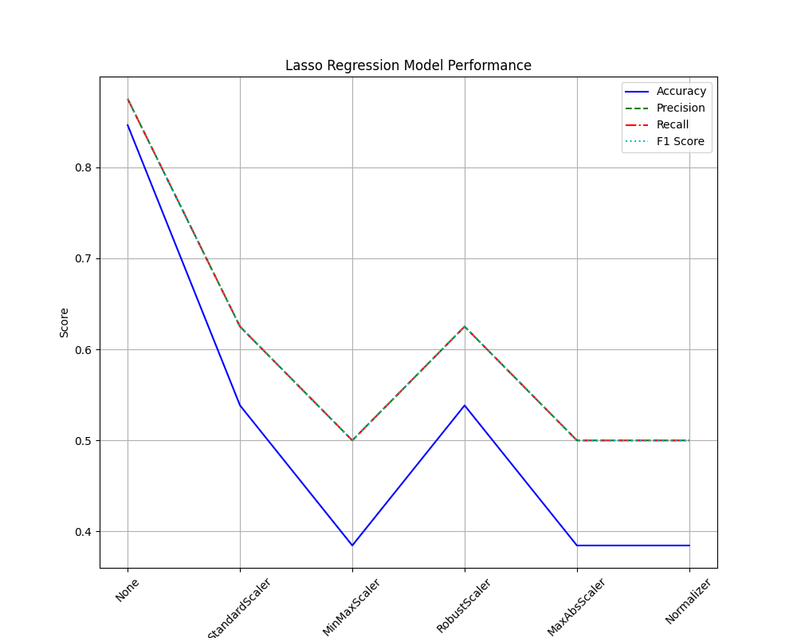
Results 2/2
The main goal of our project was to predict which teams go to the playoff, and for that the model that had the highest accuracy, was the ‘Lasso Regression Model’, with no Scaler applied to it.
As we can see, with no (None) Scaler, it obtained an accuracy of nearly 0.85 and values of Precision, Recall, and F1 Score of 0.875.
These results are very good, given that we must predict the first 8 teams of 12, and one wrong prediction has a large effect on the final results.

Slide 13
Conclusions
At this stage, we believe that the project was a success. We started by making a robust and complete analysis of the data, which allowed us to understand early on what would be useful for our prediction models, which led to efficient data cleaning in the first few weeks of the project.
As a team, we conducted research to identify and choose specific metrics that formed the foundation for the prediction models we developed. These metrics are commonly utilized by the NBA to assess players' performance.
We tested a variety of models and chose the most accurate as our ‘official’ model. By evaluating different Machine Learning algorithms, we were able to identify the weaknesses and strengths of each.

Slide 14
Anexes

Slide 15
Business understanding
In the competitive landscape of professional sports, the ability to accurately predict which WNBA teams are likely to qualify for the playoffs holds immense strategic importance for various stakeholders.
This machine learning project leverages Python and the scikit-learn library to develop a predictive model that assists decision-makers in anticipating the postseason fate of WNBA teams. By analyzing historical data, player statistics, team performance metrics, and other relevant factors, the project aims to provide valuable insights into the potential success of a team in making it to the playoffs.
For additional comprehension of the concepts used in the business, we searched the web (including the NBA official glossary) and compiled a file (Legend.md) with details about each metric that was provided in the initial dataset.

Slide 16
Business Goals
Enhance Decision-Making
Business Goal: Collect and preprocess historical WNBA team and player data, including game statistics, player performance metrics, and team records, to create a comprehensive dataset for model training.
Model Goal: Develop a predictive model using scikit-learn algorithms that effectively analyze historical data and generate accurate predictions for playoff qualification.
Strategic Planning
Data Goal: Gather data on long-term player development, draft outcomes, and coaching strategies to create a dataset that supports strategic planning for team improvement and success.
Model Goal: Develop a model that identifies key strategic factors influencing playoff outcomes, aiding teams in long-term planning and goal setting.
Competitive Advantage
Data Goal: Explore and incorporate advanced basketball analytics, player efficiency ratings, and opponent analysis to create a dataset that captures nuanced performance indicators for a competitive edge.
Model Goal: Develop a model that leverages advanced analytics to identify unique patterns and trends, giving teams a competitive advantage in predicting playoff qualification.

Slide 17
Data Analysis 1/3
Usage of Pandas’ functions such as describe(), info(), isnull(), etc., during data analysis for comprehensive insights into the provided data.
Gain a detailed understanding of the data, including its columns, data types, and potential issues.
Identification of columns with a substantial number of null values that didn't contribute relevant information to our problem.
Discovery that the 'divID' column in the 'teams' dataset was entirely filled with NaN values, leading to its removal for analysis.

Slide 18
Data Analysis 2/3
We also observed that in the table ‘players’ there were many columns with NaN values.
Column | Sum of NaN values
bioID | 0
pos | 78
firstseason | 0
lastseason | 0
height | 0
weight | 0
college | 167
collegeOther | 882
birthDate | 0
deathDate | 0
Our solution:
For the ‘pos’ column, we dropped the NaN values and kept the others. This approach is justified by the fact that if a player does not have a position in the team, it is probably an error and should not be considered.
For the columns related to the colleges, the solution we found was to make a mapping, giving each college an index.

Slide 19
Data Analysis 3/3
To gain an even deeper understanding of the data we had at hands, we used the ydata_profiling Python package to programmatically gain more knowledge from the data sources.
This package gave us information about data distribution of each table, number of instances, missing values and data correlation levels.
All this analysis is present in the “data_reports” folder of the submission.

Slide 20
Features choice 1/3
As we presented before, we created ‘important’ features that were directly used by the models: EFF, DPR, defensive_performance, offensive_performance, and TeamScore.
EFF
This is the official NBA individual player efficiency. It is derived by the following formula that we used:
(PTS + REB+ AST + STL + BLK – Missed FG – Missed FT – TO) / GP
DPR (Defensive Player Rating)
This metric shows the Defensive Prowess of a player and its defensive impact on his team. It evaluates the player’s efficiency on a defensive level and the formula is:
100 – (100 * (Def. REB + STL + BLK – PF – TO – PTS)) / GP

Slide 21
Features choice 2/3
RealTeamScore
This feature was fully invented by us. Basically, integrates the EFF individual metric of a player on a team level. It is the mean of the EFF of all players:
SUM(EFF) / COUNT(EFF)
offensive_perfomance
This metric was obtained from a basketball forum we found and decided to give it a try to complete the evaluation of the performance of a team:
((O_PTS / (O_FGA + 0.44 * O_FTA)) + ((O_FGM + O_3PM) / (O_FGA + O_3PA)) + (O_ASTS / (O_TO + 1)) + O_REB) / GP

Slide 22
Features choice 3/3
defensive_performance
Like the ‘offensive_performance’, we found this formula in the same source and also decided to use it to measure the team’s defensive performance:
(((D_FGM + D_3PM) / (D_FGA + 0.44 * D_FTA)) + ((D_FGM + D_3PM) / (D_FGA + D_3PA)) + D_REB+ D_STL + D_BLK – D_PTS) / GP
The use of these new features allowed a complete analysis of several statistics (both individually and team level), which gave us the best chance at creating a robust and efficient model.

Slide 23
Evaluation Methodology: problems
In this project, we did not use the Hold-out methodology for evaluating our models since this technique does not provide sufficient data for training and testing them. For this reason, we applied the Stratified K Folding methodology. However, the standard implementation of this technique is not suitable for the problem at hand since it splits the data regardless of its semantical meaning.
In this case, a likely scenario would be, for example, training the model with random portions of data from seasons 5 and 8, but testing would be done with the complete data from season 7. This is not a realistic scenario; therefore, it cannot be used to train and evaluate our models.

Slide 24
Evaluation Methodology: Solution
To implement a version of the Stratified K Folding technique that pays attention to the semantic meaning of the data, we followed the advice given in the theoretical classes.
Instead of grouping random data from the main dataset into k folds, we implemented an alternative that mimics the functioning of a sliding window.
Each fold only contains data from complete seasons.
The several folds are obtained by adjusting the time delta of the algorithm. For example, if the dataset contains data from 6 years and we are dividing the data into 3 folds, each fold will contain the data corresponding to 2 years.
Using this approach, we were able to train our models with different window sizes, keeping their semantic meaning and simulating a realistic situation, therefore resulting in more reliable predictions.

Slide 25
Lagged features idea
To complement the Sliding Window methodology, we applied Feature Engineering to our data.
As we mentioned before, we created Lagged Features: for each feature, we added the information of the previous X years, being X the length of the sliding window. We did this because it would improve both the accuracy and efficiency of the model.
When we tested the model, we concluded exactly that, therefore, for the other metrics that we created after to be used in the models, we kept doing that and creating the lagged features using the shift function, which made our work more accurate and robust.

Slide 26
ML MODELS EXplored
In the upcoming slide, we will enumerate the Machine Learning (ML) models employed for predicting the qualification of basketball teams for the playoffs.
In this project, we explored both regression and classifier models, depending on our target variable.
The regression models were used to predict each player’s future performance, by computing the value of the player’s EFF and DPR performance metrics in the upcoming season. Furthermore, we also used this type of model to predict the likelihood of the team’s qualification to the playoff.
We opted for regression models over classifiers due to our specific objective of computing a score ranging from 0 to 1, a metric that would determine the top 8 teams eligible for playoff qualification. This approach allowed us to scrutinize and compare the likelihoods of qualification, enabling us to select the most suitable ones, rather than blindly designating 8 teams with a "Y" label, devoid of additional criteria.
However, for pedagogical purposes, we also employed classifier models to forecast playoff qualification, offering a valuable basis for contrasting the outcomes against those produced by the regression models.

Slide 27
ML Models explored
Regression models:
Linear Regression
Random Forest Regressor
Gradient Boosting Regressor
Support Vector Regressor
Ridge Regression
Lasso Regression
MLP Regressor
Classifier models:
Linear SVC
Naive Bayes
K-Nearest Neighbours Classifier
Support Vector Classifier
Voting Classifier (Ensemble)
Logistic Regression
Random Forest Classifier
Decision Tree Classifier

Slide 28
Scalers explored
Given that the output of a Machine Learning algorithm is intricately tied to the quality of the input data it receives, we embarked on an exploration of diverse data normalization techniques. Our aim was to assess the impact of these normalization methods on the performance of each model.
To this end, we conducted a comparative analysis of the following scaling algorithms:
Standard Scaler
MinMax Scaler
Robust Scaler
MaxAbs Scaler
Normalizer
None (represents the values obtained without using a Scaler)

Slide 29
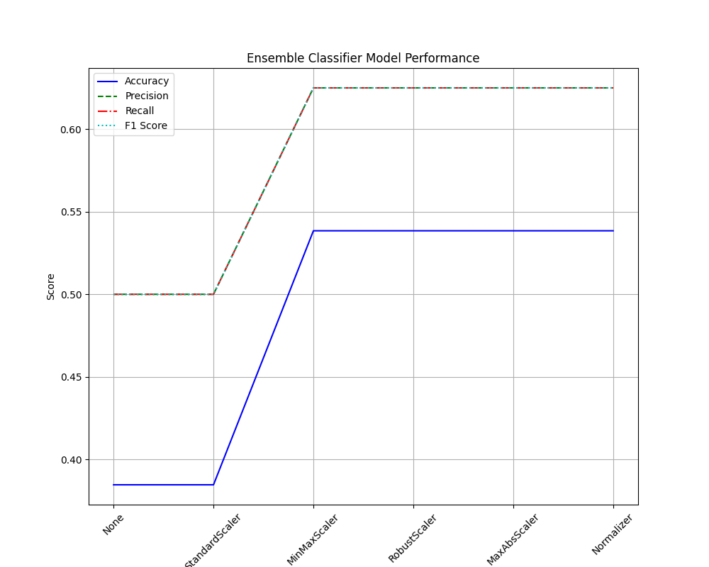
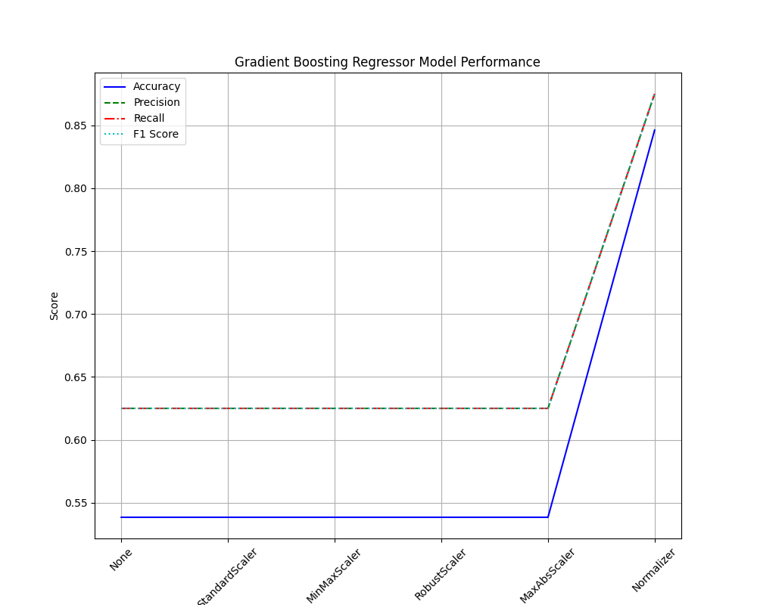
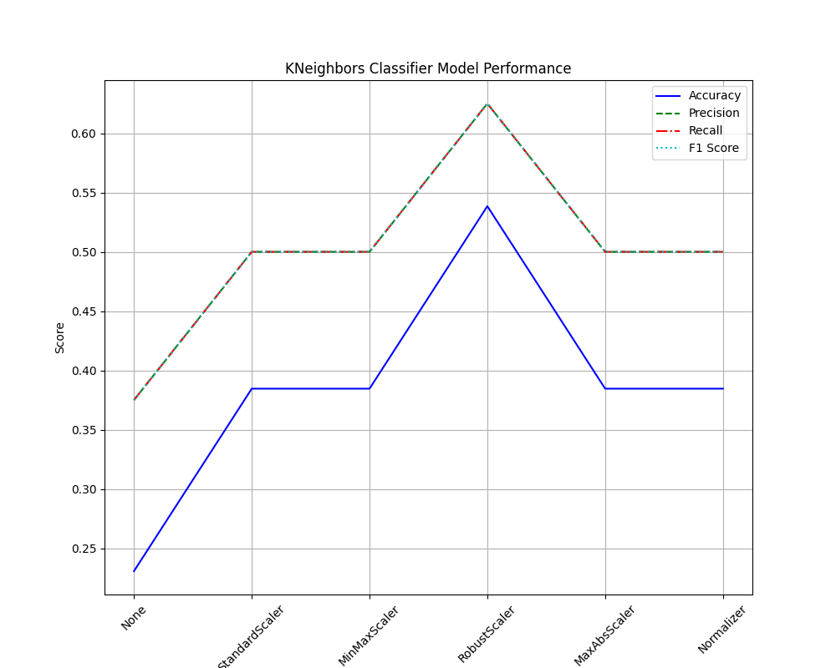
Scalers exploration results 1/3

Slide 30
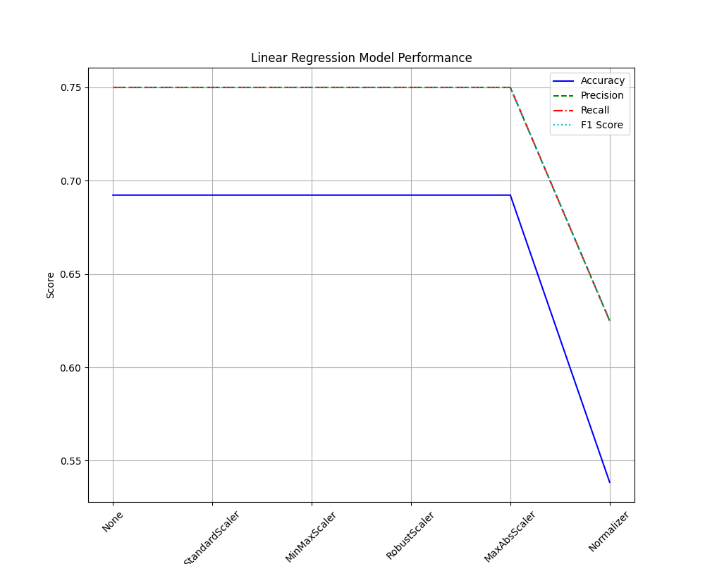
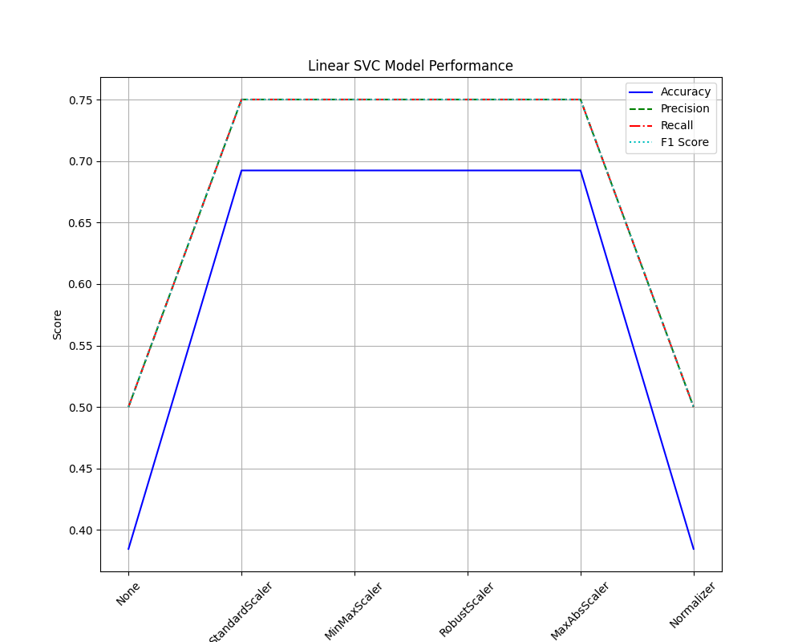
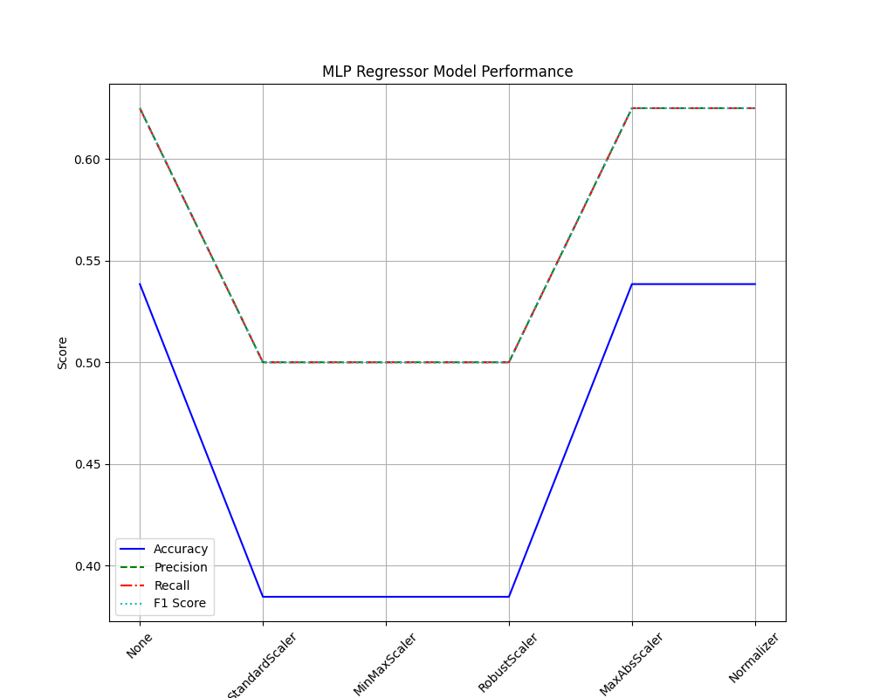
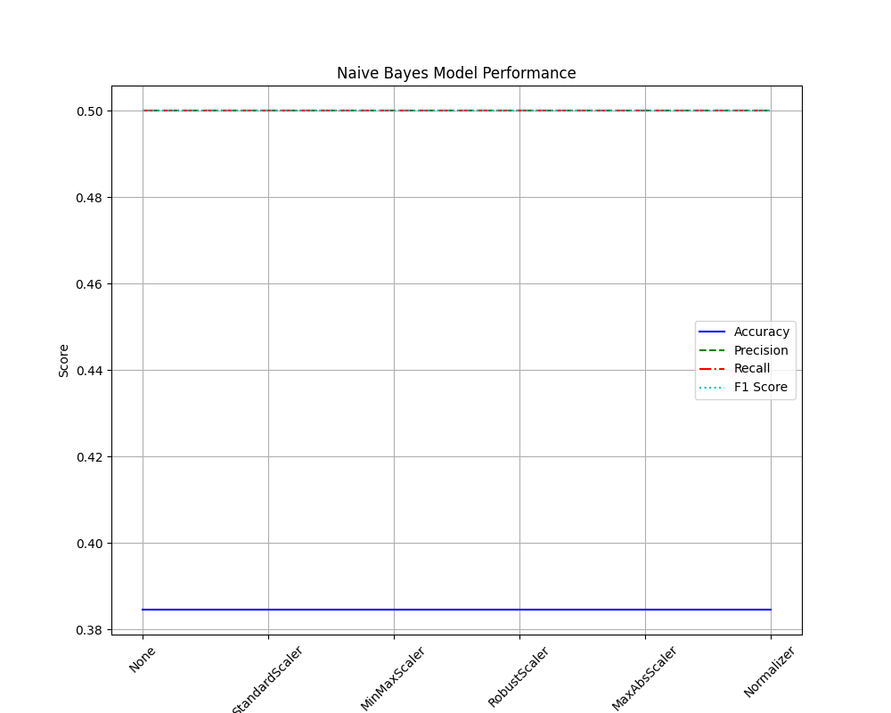
Scalers exploration results 2/3

Slide 31
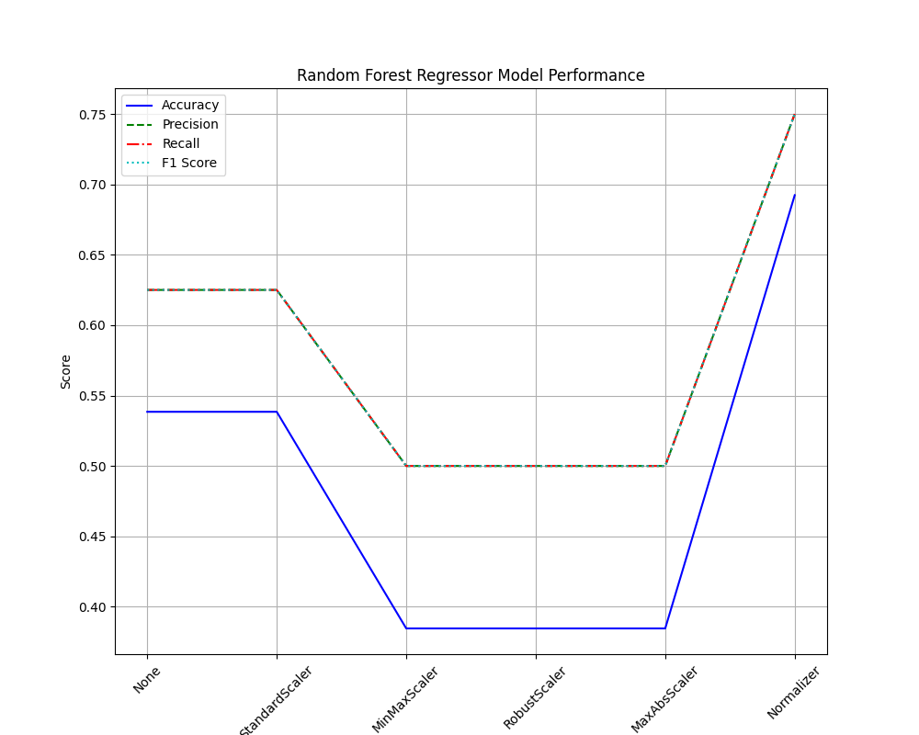
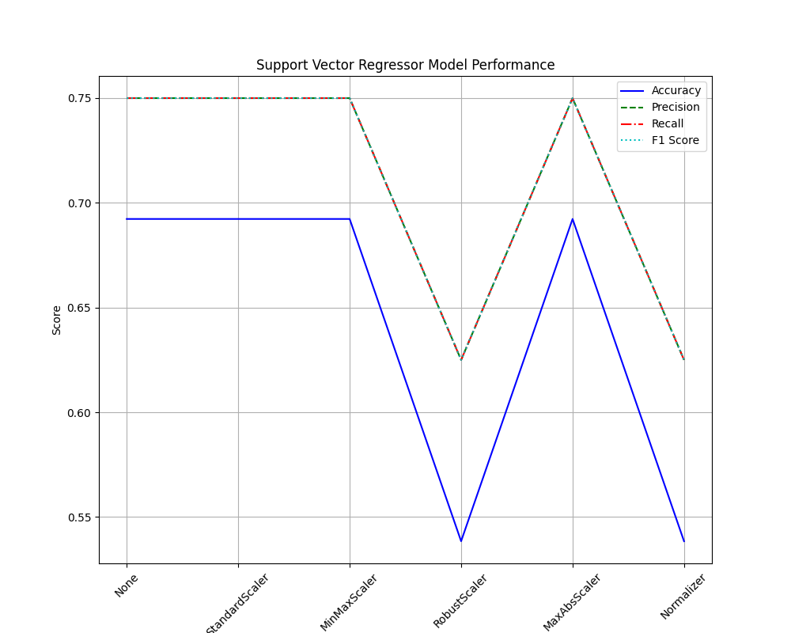
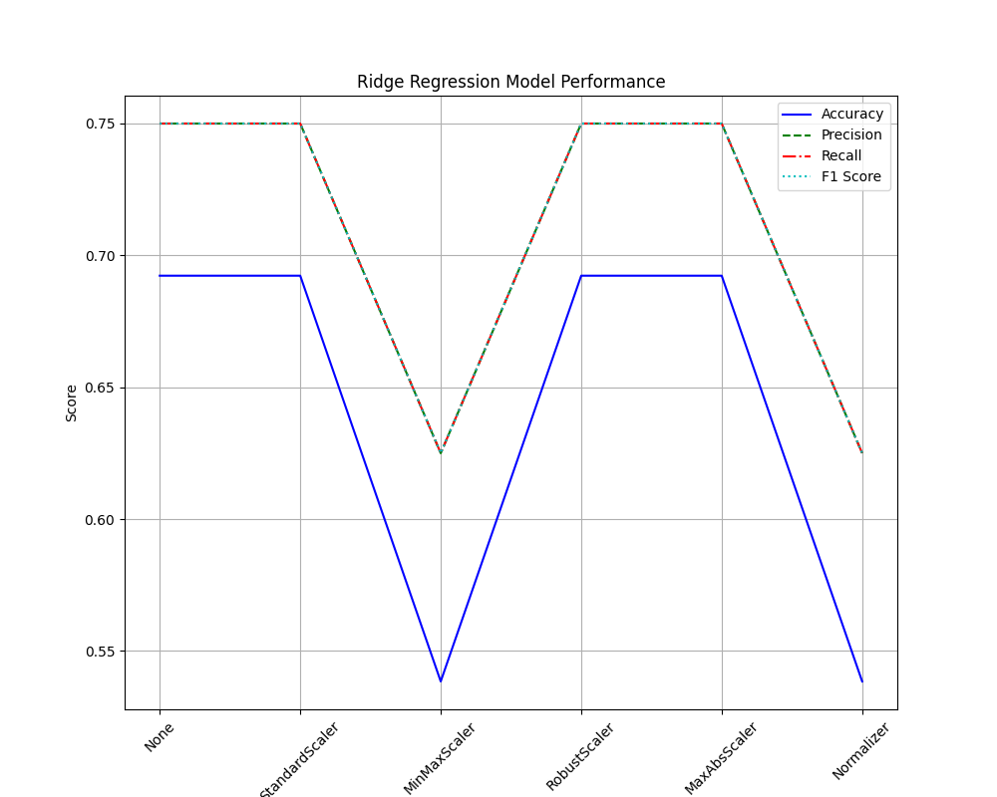
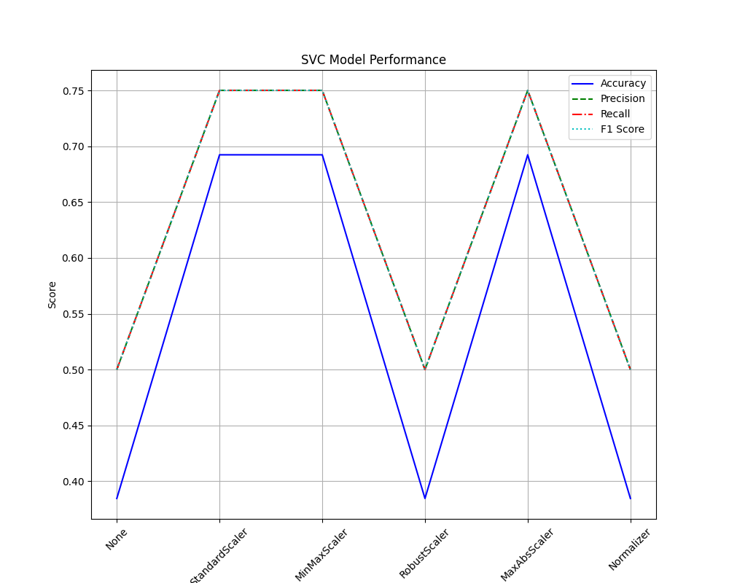
Scalers exploration results 3/3

Slide 32
SCALERS EXPLORED: ANALYSIS
Linear Regression, Support Vector Regressor, and Ridge Regression consistently achieve high scores across all Scalers, with accuracy, recall, precision, and an F1 score of 0.625 or higher.
Random Forest Regressor and MLP Regressor exhibit less consistent performance, with scores varying depending on the Scaler used. However, the overall scores are lower than the results mentioned in the previous topic.
Lasso Regression achieves the highest accuracy and F1 score among all regression models, indicating strong overall predictive capability. Furthermore, the best result was obtained without using a Scaler, since Lasso already performs regularization. This result can be explained by the following reasons:
This model performs feature selection by adjusting the coefficients of each feature, possibly removing features. This approach makes it robust against irrelevant features.
Lasso deals with redundant features by tuning the coefficients of the features, reducing the redundancy.
Overfitting is prevented by applying penalties to the magnitude of coefficients so that the model does not fit to noise
Gradient Boosting Regressor demonstrates competitive performance with high accuracy, recall, precision, and an F1 score with the Normalizer Scaler.
As expected, Naïve Bayes did not perform well in this problem. We were counting on this outcome, because this algorithm assumes that all the features are completely independent, however, as displayed in the confusion matrices, the columns have some correlation among them, therefore invalidating the assumption made by Naïve Bayes and leading to poor performance.

Slide 33
SCALERS EXPLORED: ANALYSIS
The choice of Scaler significantly impacts the performance of most regression models, as scores vary across different Scalers.
The "None" Scaler is used for some models, indicating that no data scaling was applied. These models achieve mixed results, highlighting the potential benefit of data scaling in certain cases.
It is important to highlight that the testing process used to collect this data closely mirrors the conditions of the final Kaggle evaluation. However, this similarity gives rise to a specific challenge: in each season, an average of 13 teams compete, but only 8 secure a spot in the playoffs. Consequently, any misjudgment carries a substantial impact on the evaluation metrics.
For example, if the model anticipates the qualification of a team that does not make it, this single error accounts for 2/13 or 15,4% of the final accuracy value. This is because an erroneous prediction of a team's qualification implies the incorrect prediction that another team did not qualify when it should have, effectively doubling the impact of the mistake.
In summary, the data obtained offers valuable insights into the performance of various Machine Learning models across different data scaling techniques. It highlights the importance of selecting appropriate Scalers for different models and tasks. Additionally, it indicates that some models are more robust across different Scalers, while others exhibit sensitivity to the choice of scaling method.

Slide 34
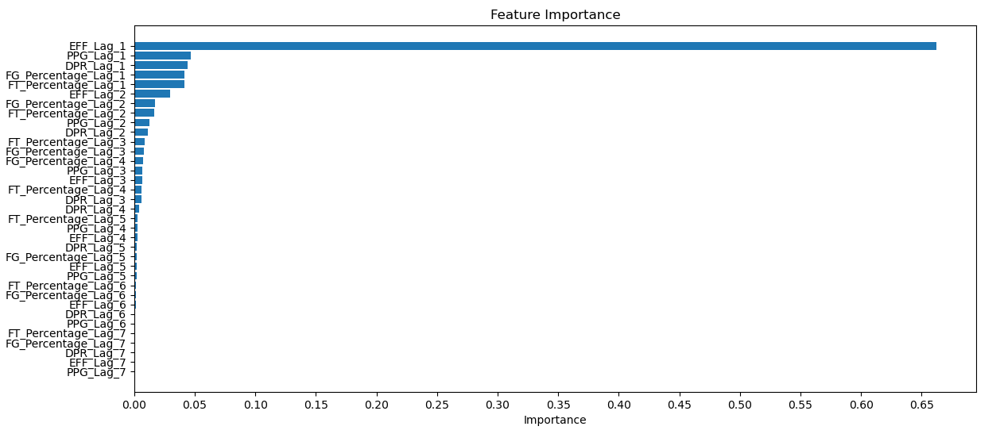
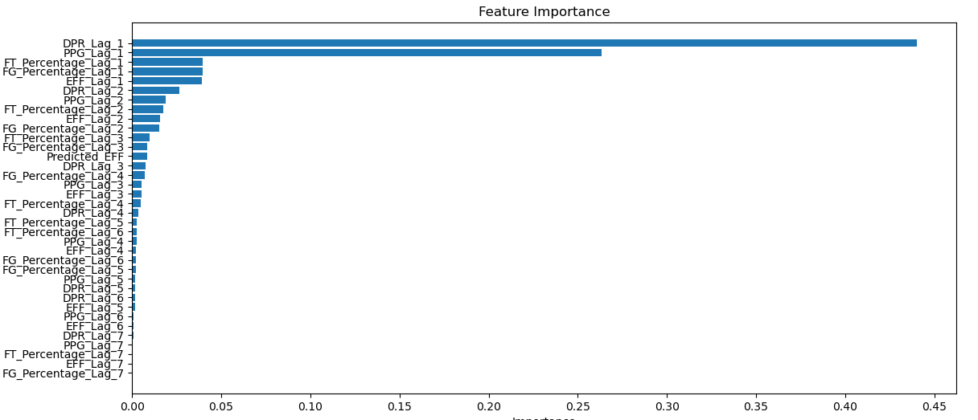
Feature’s Importance
The plot on the left shows the feature’s importance by weight plot for predicting the EFF for the players
The plot on the right shows the feature’s importance by weight plot for predicting the DPR for the players

Slide 35
Game simulation alternative
Using the series_post dataframe we were able to create an alternative method of determining the teams going to the playoffs.
By using the data of individual games in the series_post we were able to create a model capable of predicting the odds of a particular team winning.
Data passed to the model:
Lagged: 'RealTeamScore', 'defensive_performance', 'offensive_performance', 'gamesWLRatio', 'homeWLRatio', 'awayWLRatio', 'confWLRatio', 'progress', 'playoff’
Current: ‘PredictedTeamScore’
With this model, we then ran simulations of the games for the standard season to determine the best teams.
Right from the start, we had doubts about this model due to the lack of individual game data (only 70 games to train and test on)
The obtained results proved that this approach is not reliable:
Accuracy: 69.2 %
Precision: 75%
Recall: 75%
F1 Score: 75%

Slide 36
Final project result
Qualified for the playoffs:
Los Angeles Sparks
San Antonio Silver Stars
Phoenix Mercury
Indiana Fever
Seattle Storm
New York Liberty
Connecticut Sun
Washington Mystics
Not qualified:
Minnesota Lynx
Chicago Sky
Atlanta Dream
Tulsa Shock

Slide 37



Technologies/tools
To develop this project, we used different technologies like libraries to draw plots or libraries specific for Machine Learning:
Pandas – Data manipulation by using Dataframes and analysis
scikit-learn – Machine Learning models
Numpy – Numerical computing in some special cases
MatPlotLib – Plot drawing and visualization
Seaborn – Data visualization integrated with MatPlotLib
Math – Mathematical Functions
YData Profiling – Comprehensive analysis of the initial dataset

Slide 38
rEFERENCES
https://en.wikipedia.org/wiki/Efficiency_(basketball)
https://machinelearningmastery.com/machine-learning-in-python-step-by-step/
https://realpython.com/python-data-cleaning-numpy-pandas/
https://www.nba.com/stats/help/glossary
https://www.datacamp.com/tutorial/matplotlib-tutorial-python
https://docs.profiling.ydata.ai/latest/

